Slide 1
Quantitative Research Methods
Matthew Ivory
matthew.ivory@Lancaster.ac.uk

Slide 2
1. Introduction to the course
Session 1: Introduction to quantitative research methods using R
Session 2: Data management and data wrangling
Session 3: Exploratory data analysis
Session 4: Data visualization
Session 5: Data Wrangling Example, Mid-term assignment
Session 6: Probability and distributions
Session 7: Tests for discrete variables: Analysing contingency tables
Session 8: Correlations and t-tests.
Session 9: ANOVA and linear regression
Session 10: Multiple regression, introduction to generalised linear regression

Slide 3
Session Outline
1. Last session refresher
The take home tasks
The mid-term assignment
2. Quantitative Research
The PPDAC cycle
The data science workflow
3. Getting to know Rstudio

Slide 4
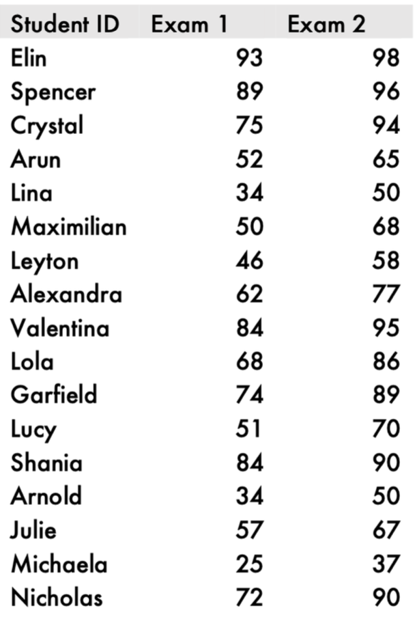
1. Refresher – take home tasks
The solutions to the tasks and all the other R related content in last week’s worksheet is available (The worksheet looks the same, but it will have the output underneath each section)
This table displays the scores of students in two foreign language exams, one administered at the beginning of term, the other at the end of term.

Slide 5
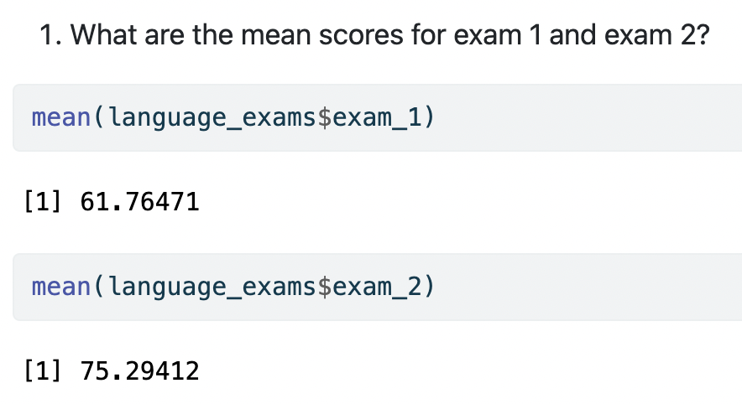
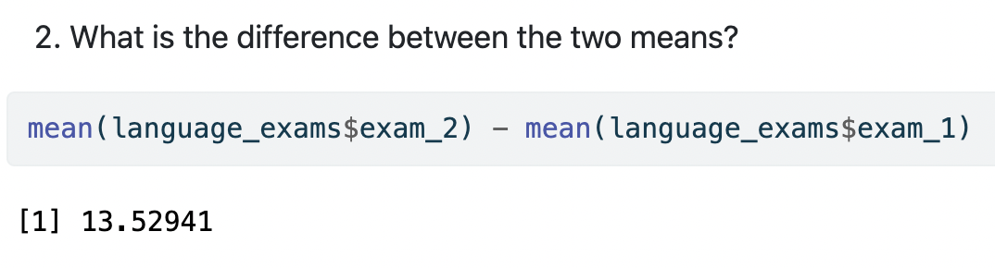

Slide 6
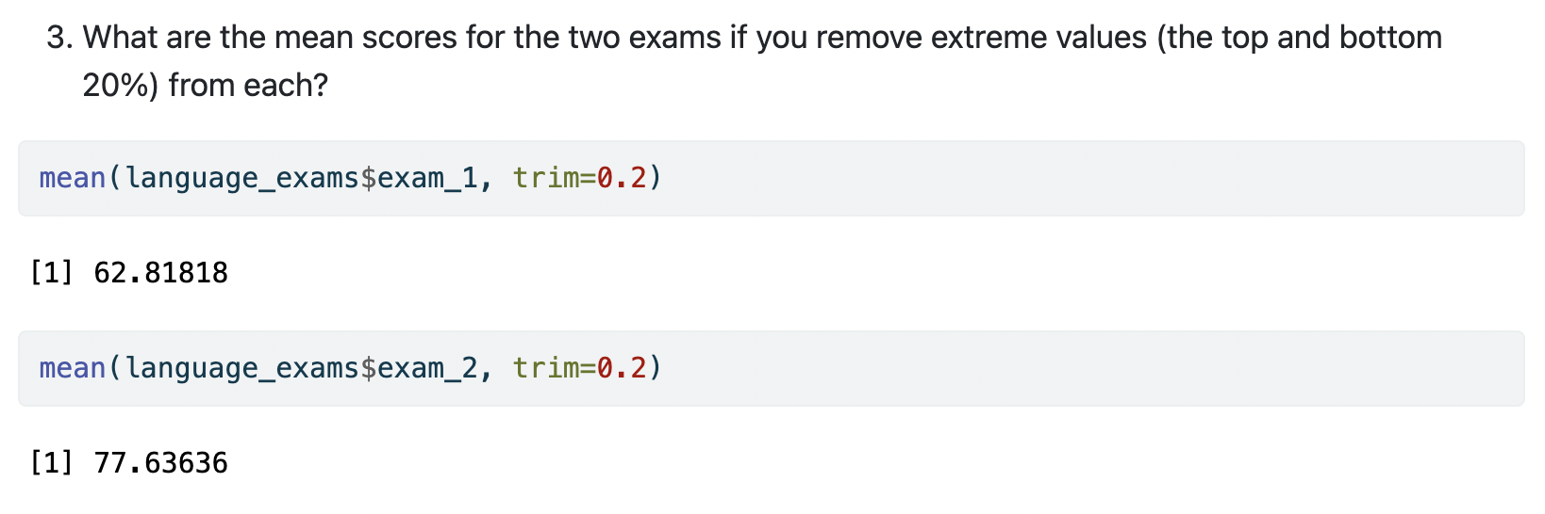
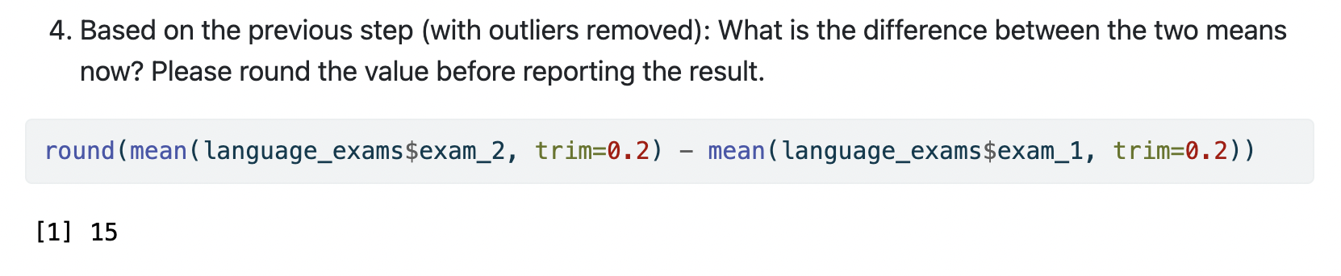
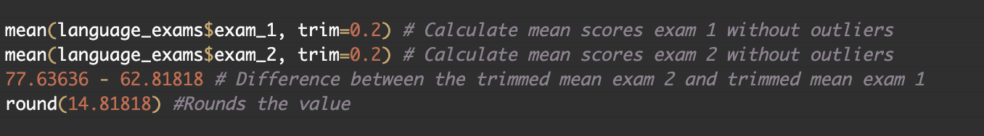

Slide 7

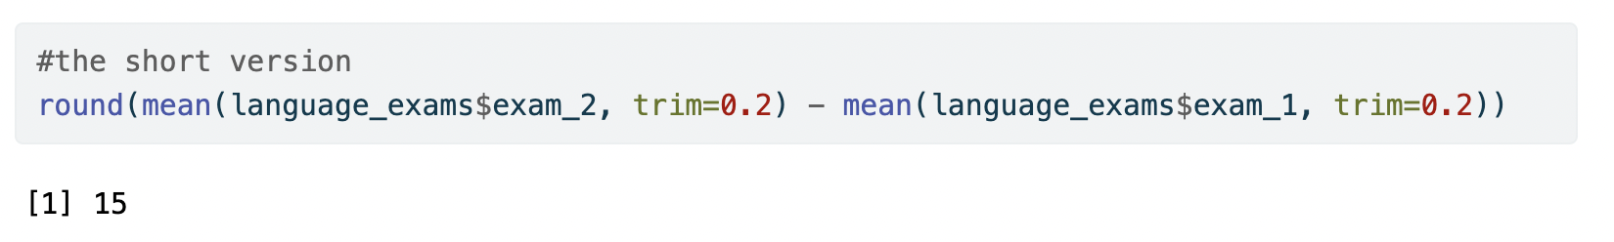
Notes:
You may have written your code differently, if you arrive at the same answer - it isn't wrong per se

Slide 8
Mid-term Assignment
Information is on Moodle
See “Assessment” for the coversheet and submission criteria
See “Mid-term assignment, due Monday, Feb 19, 2024, 12pm” for assessment files
Asked on content learnt in weeks 2, 3, and 4.
Reading in data
Descriptive analysis
Producing plots
Successful interpretation and reasoning on information in plots
1,500 words: an upper limit only
Submit your answers to questions (with coversheet) and R script
R script is not assessed, but I will give feedback on structure/layout etc.

Slide 9
Two basic strategies in quantitative research
Observational research
Simply observe and describe behaviour in natural situations
Example: Systematic reviews, corpus analyses, correlational research, etc.
Experimental research
Systematically manipulate variables of interest and see what effect our manipulation has in the world
Example: Experimental studies in the lab or in the wild

Slide 10
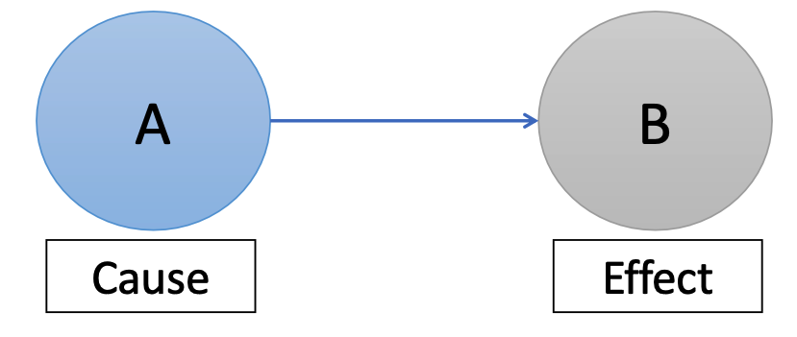
Experimental Research
In experimental research, we try to discover causal relationships between variables
We do this by manipulating certain variables to test the outcome on other variables
We randomly assign participants to groups where they experience different manipulations or their environment
Example: higher levels of glucose improves cognitive function following an overnight fast, but lower doses are better following shorter fasts (Owen et al., 2011)

Slide 11
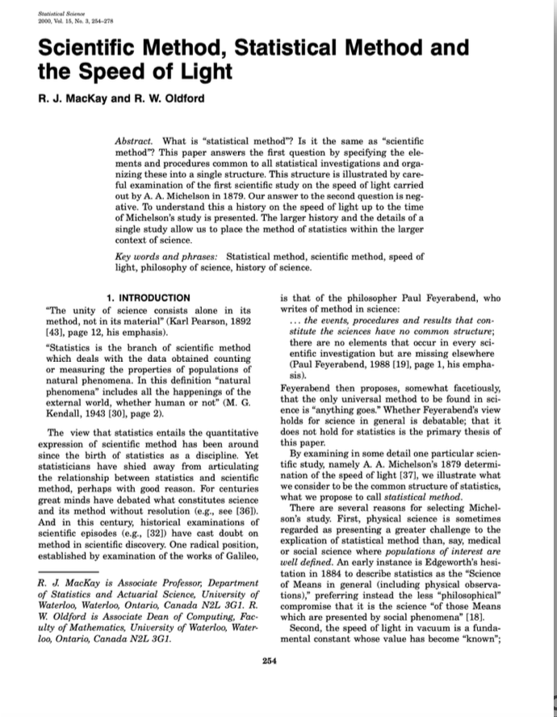
The statistical method: PPDAC (MacKay & Oldford, 2000)
Statistical method
“Elements and procedures common to all statistical investigations”
Can be represented as a series of five interconnected stages:
Problem
Plan
Data
Analysis
Conclusion

Slide 12
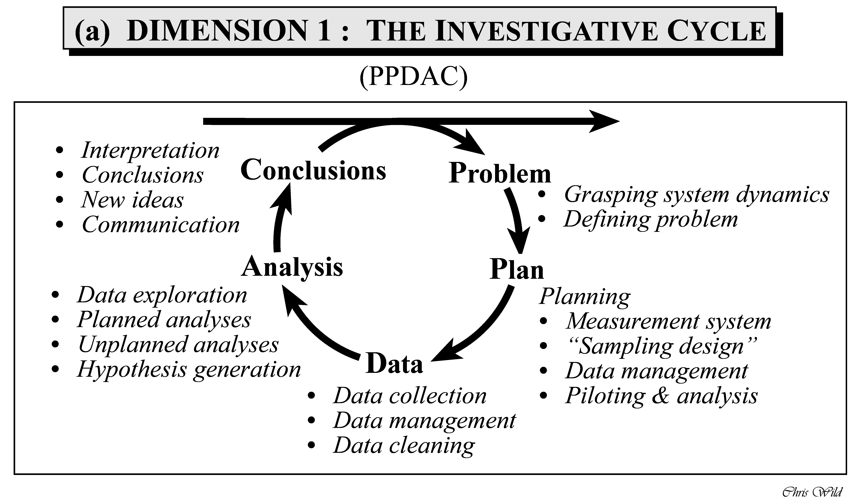
+ Ethics approval
+ Preregistrations
This Photo by Unknown Author is licensed under CC BY-SA

Slide 13
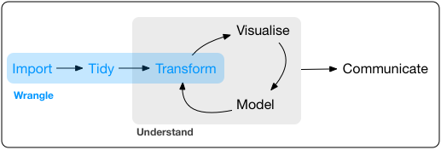
The Data Science workflow
Data science: the combined application of computational tools and statistical methods to (all aspects of) data analysis.
This Photo by Unknown Author is licensed under CC BY-SA

Slide 14
Step 1: Wrangling
Data can be messy (e.g., there might be missing values). Before analyzing the data, we need to ”tidy” it.
Data wrangling: The process of preparing raw data for further analysis.
This Photo by Unknown Author is licensed under CC BY-SA

Slide 15
Step 2: Visualise
Once data is tidy, we use computational tools and statistical methods for data exploration and visualization.
The aim is to discover potentially interesting patterns and behaviours in the data.
We will focus on this in sessions 3 and 4.
This Photo by Unknown Author is licensed under CC BY-SA

Slide 16
Step 3: Model
The visualisation and exploratory analysis (step 2) leads us to a probabilistic model of the data.
This is a model of the phenomenon that generated the data.
Modelling involves statistical inference and model evaluation.
This Photo by Unknown Author is licensed under CC BY-SA

Slide 17

Step 4: Communicate
We disseminate our results (e.g., presentations, publications, corpora).
• But: Science should be open, transparent and reproducible, so we should also share materials, data and scripts via freely available platforms (e.g., OSF).
• This way, others can replicate our studies and build on our research.
This Photo by Unknown Author is licensed under CC BY
This Photo by Unknown Author is licensed under CC BY-SA

Slide 18
Getting to know RStudio
In last week’s worksheet, I said two things
“We will discuss how to import files next week”, and
“I don’t like nesting functions and neither should you”
The first comment we will look at in today’s worksheet,
The second comment I will address now, as it will be used implicitly throughout the rest of the course

Slide 19
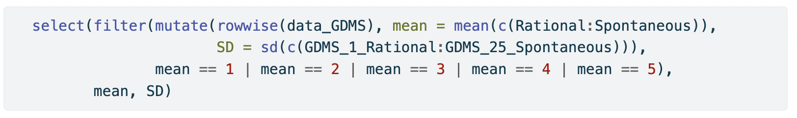

Nested functions are bad
Why?
They are hard to read and quickly become very dense
How do we fix this?
Using tidy functions and pipes
This Photo by Unknown Author is licensed under CC BY-NC

Slide 20

Packages and Libraries
In R, we are only limited in terms of what we know and what our computer can handle
R comes with certain functions pre-packaged (often called base R)
Like mean() or sd()
We can add in additional functions through packages or libraries (which are collections of packages)
A package is a collection of functions that are bundled together, these can be downloaded from CRAN and used locally on your computer

Slide 21
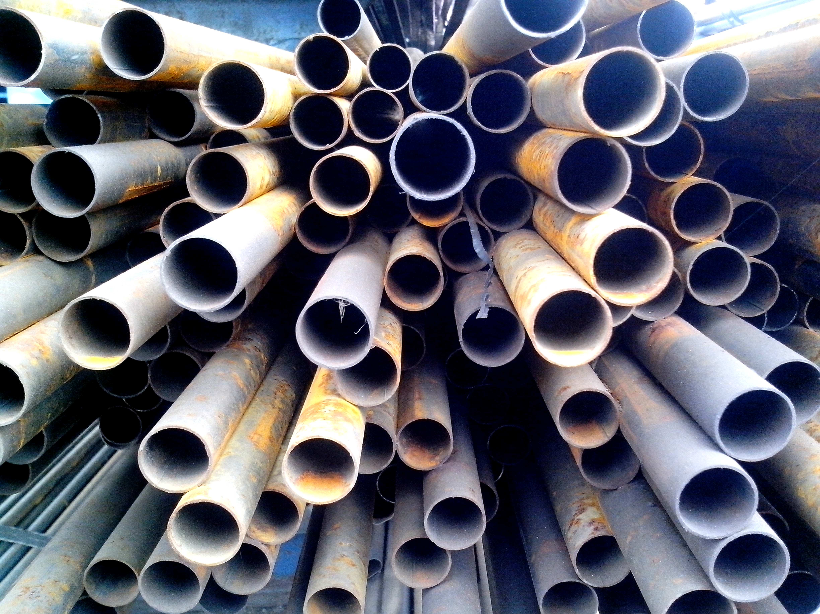
The Tidyverse library
Tidyverse is a collection of packages that are aligned through their approach to data science and share an underlying design philosophy, grammar, and data structures
It includes many functions that we will be using throughout the course
One thing that comes with tidyverse and is a large part of writing in the “tidy style” are pipes
%>% or |>

Slide 22
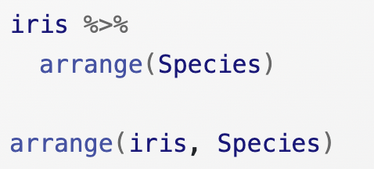
Pipes Primer
Tidy pipes allow us to format our code so that it runs across multiple lines and enhances readability
Use %>% to emphasise a sequence of actions, rather than the object that the actions are being performed on.
Pipes take the data object (such as a dataframe) and ‘pipes’ it into the RHS function
Dataframe %>% function() %>% function %>%...
Pipes replace nested functions and are easier to follow and read – they are also easier to troubleshoot
Do not worry too much about pipes right now, they will be introduced, and you will get a chance to get familiar with them

Slide 23
This week’s worksheet
Scripts
Installing and loading packages
Working directories and clean workspaces
Loading data (various formats)
Examining datasets
Closing your R session

Slide 24
Questions?
I will be walking around while you work through the worksheet

